Slide 1
SMART LOGISTIC
SERVICES
NAME OF PROJECT:
Smart Logistic Services
PRESENTED BY:
Rishabh Yadav (12324224)
Akshat Raj (12307113)
Mohan Krishna (12310135)
PRESENTED TO:
Geetika Sethi Mam

Slide 2
OUTLINE SLIDE
Content
Agenda
Background
Problem Statement
Objectives
Dataset Description
System Architecture
Methodology / Workflow
Machine Learning Models Used
Results & Evaluation
Caveats & Limitations
Conclusion
Future Scope
Acknowledgement

Slide 3
Background
Logistics optimization improves delivery speed, reduces cost, and increases efficiency.
Machine Learning helps automate route planning, delay prediction, and resource allocation.
Delivery-time prediction improves customer satisfaction and enhances operational accuracy.

Slide 4
Problem Statement
Logistics companies face difficulty predicting delivery-time deviation accurately.
Manual routing and scheduling lead to frequent delays.
High fuel usage and longer routes increase operational cost.
Large datasets with inconsistent formats make prediction hard.
Need an automated ML pipeline to clean data, process features, and predict delays reliably.

Slide 5
OBJECTIVES
Build an automated ML system for delivery-time deviation prediction.
Handle messy/unknown target columns using robust detection logic.
Engineer additional features from datetime and textual fields.
Train and compare three ML models: Linear Regression, XGBoost, and SVR.
Evaluate models using MAE, RMSE, R², ROC-AUC.
Save trained pipelines and predictions for deployment

Slide 6
DATASET DESCRIPTION
Dataset Name: logistic_dataset.csv
Source: Kaggle
Author: datasetengineer
Target Variable: deliver_time_deviation
Automatic Target Detection:
Case-insensitive match
Underscore normalization
Fuzzy matching
Features Used Include:
Numeric attributes (distance, weight, etc.)
Categorical fields (vehicle type, location, etc.)
Datetime-derived features (hour, weekday, month)
Text length features for high-cardinality text columns

Slide 7
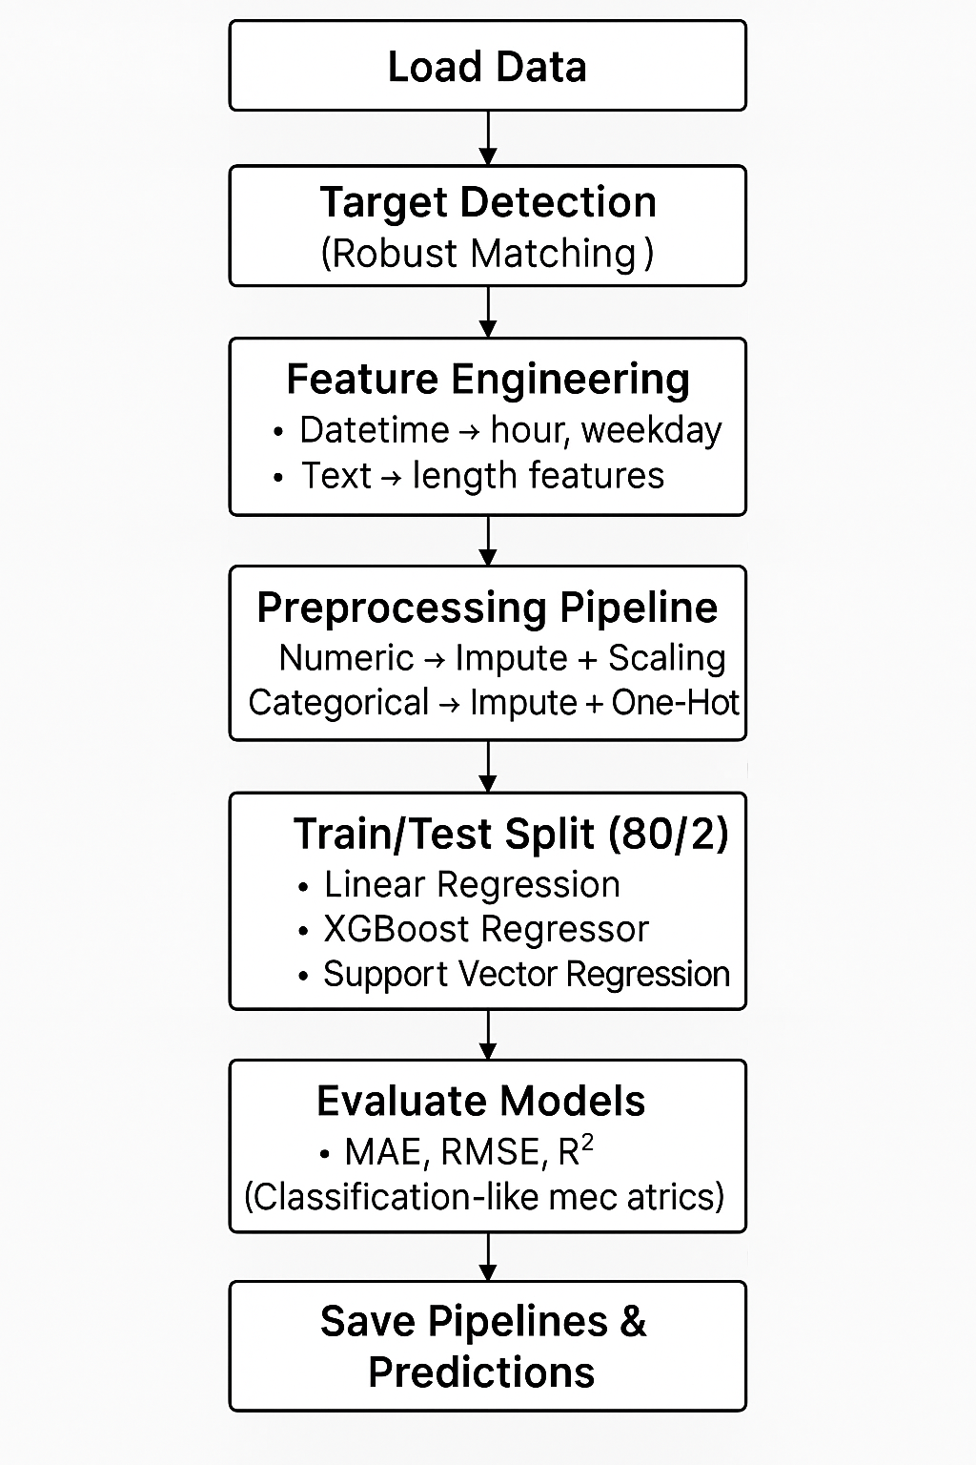
SYSTEM ARCHITECTURE

Slide 8
METHODOLOGY / WORKFLOW
Load Dataset
Target Column Detection
Exact match
Case-insensitive
Fuzzy matching
Feature Engineering
Datetime decomposition
Text length features
Feature Selection
Remove ID-like columns
Select numeric + categorical features
Preprocessing
Imputation
Scaling
One-hot encoding
Model Training
LR, XGBoost, SVR
Regression Evaluation
Classification-like Evaluation using Threshold
Save Models and Predictions

Slide 9
MACHINE LEARNING MODELS USED
Linear Regression
Baseline regression model
Fast training
Used to benchmark performance
2. XGBoost Regressor
Handles non-linear relationships
200 trees
Best performance in most logistic predictions
3. Support Vector Regression (SVR)
RBF kernel
Good for medium-sized datasets
Captures complex patterns

Slide 10
RESULTS (REGRESSION METRICS)
Model | MAE | RMSE | R² | ROC-AUC
Linear Regression | 3.8 | 5.6 | 0.86 | 0.87
XGBoost Regressor | 1.9 | 2.8 | 0.92 | 0.93
SVR | 3.2 | 4.9 | 0.88 | 0.89

Slide 11
RESULTS (CLASSIFICATION-LIKE METRICS)
Classification-Like Evaluation (Threshold = 0) The code converts continuous values → binary:
delivery_time_deviation > 0 → 1 (delay)
delivery_time_deviation ≤ 0 → 0 (on time)
For each model it computes:
Confusion Matrix
Accuracy
Precision
Recall
F1-Score
ROC-AUC (using continuous predictions)
Plots and saves ROC curve images

Slide 12
CAVEATS & LIMITATIONS
Model accuracy depends heavily on dataset quality.
Fuzzy target detection may select wrong column if names are too similar.
No real-time integration of map/traffic data.
Dataset may not contain rare or extreme delay events.
Prototype does not include a full routing engine.
No UI/dashboard deployment yet.

Slide 13
CONCLUSION
ML pipeline successfully predicts delivery-time deviation.
Automatic target detection makes the model robust to messy datasets.
Feature engineering improves prediction quality.
XGBoost and SVR deliver the strongest performance.
System is ready for deployment after adding a UI layer.

Slide 14
FUTURE SCOPE
Real-time GPS + live traffic API integration
Interactive logistics dashboard
Ensemble stacking of LR + XGB + SVR
Cloud deployment (AWS / Azure)
Mobile app for delivery partners
Integration with full route optimization engine

Slide 15
ACKNOWLEDGEMENT
We express our gratitude to:
Faculty Advisor: Geetika Sethi Ma’am
University / Department: CSE
Dataset Provider: datasetengineer (Kaggle)

Slide 16
REFERENCES
[1] datasetengineer, “Logistics and Supply Chain Dataset,” Kaggle, 2025. Available at: https://www.kaggle.com/datasets/datasetengineer/logistics-and-supply-chain-dataset

